Slide 1
DOCUMENT #: | GSC15-GRSC-12
FOR: | Presentation
SOURCE: | ITU-R
AGENDA ITEM: | 8
CONTACT(S): | Colin.Langtry@itu.int
ITU preparations for WRC-12
Colin Langtry,
Counsellor, ITU-R SG 5
Global Standards Collaboration (GSC) GSC-15

Slide 2
Timetable
~ 2.5 years of studies
Situation as of today
Deadline for
contributions 31 Jan. 2011

Slide 3
Topics being considered
Chapters of CPM Report
WRC-12 Agenda items
1. Maritime and Aeronautical issues
2. Radiolocation and Amateur issues
3. Fixed, Mobile and Broadcasting issues
4. Science issues
5. Satellite issues
6. Future work programme and other issues
1.3, 1.4, 1.9, 1.10
1.14, 1.15, 1.21, 1.23
1.5, 1.8, 1.17, 1.20, 1.22
1.6, 1.11, 1.12, 1.16, 1.24
1.7, 1.13, 1.18, 1.25, 7
1.2, 1.19, 2, 4, 8.1, 8.2
2

Slide 4
Responsible ITU-R Groups
WRC-12 (agenda items)
CPM Report
WP 1A
1.6
1.22
Chapter 1 (draft texts)
Chapter 2 (draft texts)
WP 1B
1.2
1.19
Chapter 3 (draft texts)
WP 4A
1.13
Chapter 4 (draft texts)
Technical aspects
Chapter 5 (draft texts)
SC
7
Regulatory and procedural aspects
Chapter 6* (draft texts)
WP 4C
1.7
1.18
1.25
WP 5A
1.23
CPM Management Team Meeting
1.3
1.4
1.9
1.10
WP 5B
1.14
1.15
1.21
Draft CPM Report
SC
WP 5C
1.5
1.8
1.20
WP 7B
1.11
1.12
1.24
CPM11-2
WP 7C
1.16
JTG 5-6
1.17
CPM Report to WRC-12
WP 1A
WP 4A
SG 7
8.1 sub-issues
* includes also a.i. 2, 4, 8.2

Slide 5
Agenda items of particular interest
1.2: take appropriate action with a view to enhancing the international regulatory framework – Res. 951 (Rev.WRC-07)
1.17: consider sharing studies between the MS and other services at 790-862 MHz in Regions 1 and 3 to ensure the adequate protection of services in this frequency band
1.19: consider regulatory measures in order to enable introduction of software-defined radio and cognitive radio systems
1.22: examine effect of emissions from SRD on radiocommunication services
8.2: Items to be included in WRC-15 Agenda (Res. 806 (WRC-07))
4

Slide 6
Regional group meetings:
APG2012-3, 8 – 12 March 2010, Bangkok, Thailand
APG2012-4, 13 – 18 December 2010, Hong Kong, China
Asia Pacific Telecommunity
13th ASMG, 1 – 6 March 2010, Tunis, Tunisia
14th ASMG, 28 Nov. – 3 Dec. 2010, Beirut, Lebanon
1st meeting, Geneva, 14-16 Sept. 2009
[2nd meeting scheduled on 2010]
African Telecommunications Union
CPG12-5, 24 – 26 February 2010, Ponta Delgada, Portugal
CPG12-6, 28 Sep. – 1 Oct. 2010, Berlin, Germany
European Conference of Postal and Telecommunications Administrations
XIV PCC.II, 10 – 13 November 2009, Washington, USA
XV PCC.II, 31 Aug. – 3 Sept. 2010, Fortaleza, Brazil
Inter-American Telecommunication Commission
WG-5: 29 March – 1 April 2010, Yerevan, Armenia
COMs: 7 – 9 September 2010, Baku, Azerbaijan
WG-6: 27 – 29 October 2010, Minsk, Belarus
Regional Commonwealth in the field of Communications

Slide 7
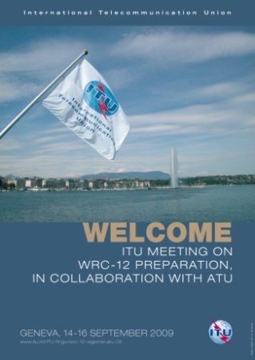
Information meetings for WRC-12
Organized in collaboration with ATU
14 – 16 September 2009, ITU Headquarters, Geneva
Presentation of the organization, preliminary views, priorities and positions of the 6 regional groups
Presentation and review of the ITU-R preparatory studies by some Chairmen of the responsible groups
2nd Meeting, 24 & 25 Nov. 2010
ITU Headquarters, Geneva
Presentation of the Draft CPM Report to WRC-12 (explanation of the draft Methods to satisfy the WRC-12 Agenda items)
Presentation and review of the regional groups’ draft preliminary views, positions and common proposals
Planned to be held in 2011
Presentation of the CPM & Dir. Reports to WRC-12
Presentation and review of the regional groups’ draft views, positions and common proposals
3rd
Meeting

Slide 8
Supplementary Slides

Slide 9
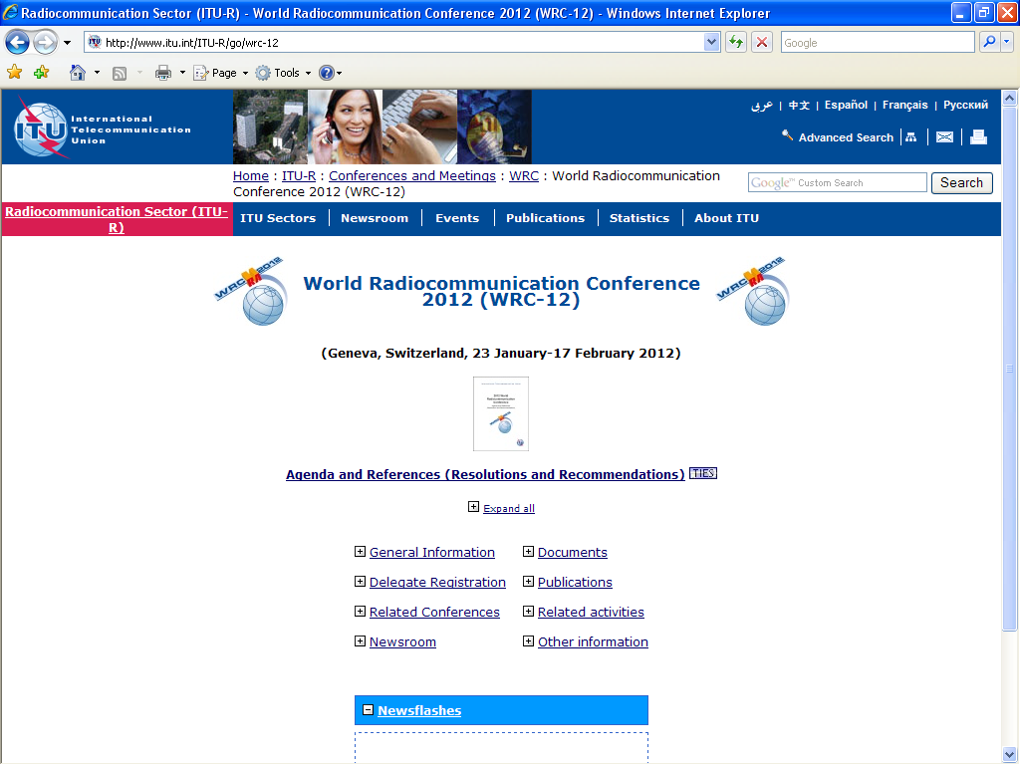
http://www.itu.int/ITU-R/go/wrc-12

Slide 10
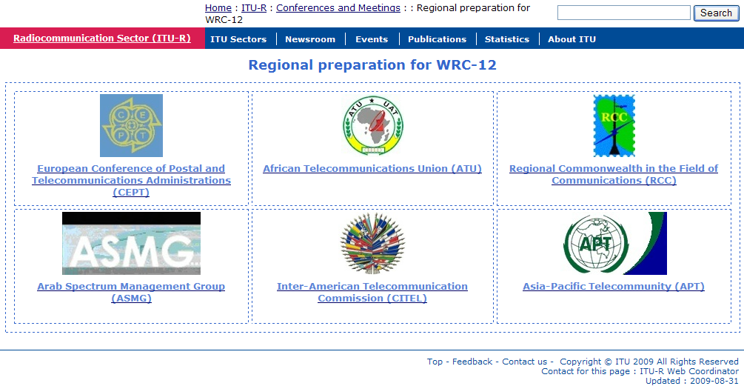
http://www.itu.int/ITU-R/go/wrc-12-regional
http://www.itu.int/ITU-R/go/wrc-12-apt
http://www.itu.int/ITU-R/go/wrc-12-cept
http://www.itu.int/ITU-R/go/wrc-12-asmg
http://www.itu.int/ITU-R/go/wrc-12-citel
http://www.itu.int/ITU-R/go/wrc-12-atu
http://www.itu.int/ITU-R/go/wrc-12-rcc

Slide 11
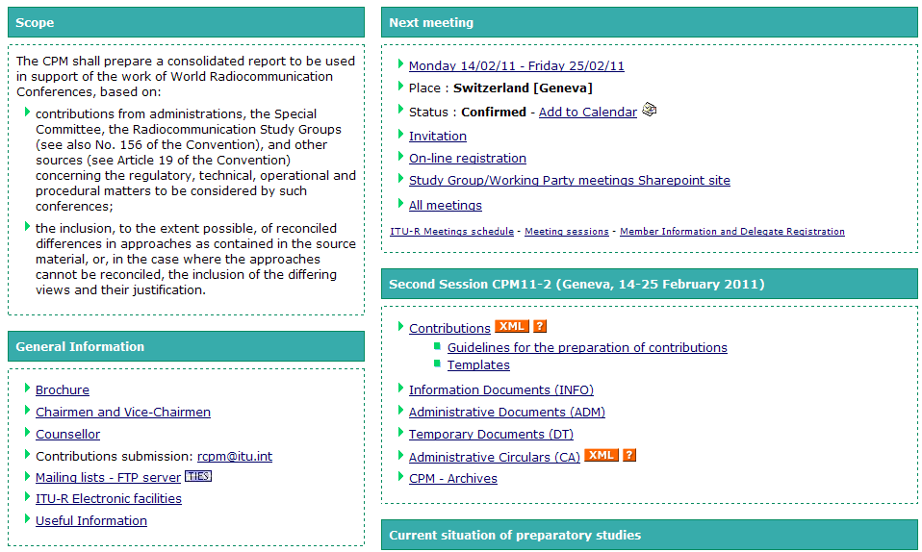
http://www.itu.int/ITU-R/go/rcpm

